Slide 1
International Taxation.
The tax problem is deliciously more complicated when multiple governments are involved.
Consider first a simple problem of capital allocation by a multinational firm that faces only sourced-based taxes, so its home country does not tax foreign income. No income shifting.
This firm seeks to maximize
subject to
First order condition:
Note that the taxes are marginal taxes.

Slide 2
Marginal or average?
What if firms make discrete location choices?
For example, choose j to maximize
Here these are average tax rates, and the firm locates where after-tax profit is highest.
Locations are substitutes here, which they need not be in the first formulation.
There is something odd about this setup.
  There are rents, but the firm pays no royalties.
  As a result it can simply assign profits to different locations.
  This is not right, even though it’s commonly assumed.

Slide 3
What is the cross-sectional pattern?
One can run a regression
Consistently the evidence points to there being greater investment in low-tax places.
  For example, Djankov et al. (AEJ: Macroeconomics, 2010).
Is this a valid test of the model? What might be missing or wrong? Does it matter whether one has fully controlled for non-tax factors that influence investment levels?
Should this regression be run at an aggregate level or at the firm level? What does it mean at a firm level?
Should this be run as a panel or cross section?
Should tax effects vary by industry or business line?

Slide 4
Add income shifting.
Suppose that firms need not report “true” income, but any misreporting is costly.
Maximize
With ρ_{i} “true” income, ψ_{i} the supplement.
Say that
First order condition

Slide 5
Profit shifting implications.
The first order condition implies
Profit under-reporting increases with τ_{i}.
Take logs, and apply a first-order Taylor:
Then if you have factors that proxy for ρ_{i}, you can infer profit shifting.
The log formulation is helpful here.

Slide 6
More profit shifting.
The Hines/Rice 1994 paper used aggregate data.
In that paper, ρ_{i} is proxied by labor and capital inputs, plus per capita GDP.
The variation that papers in this tradition use is the τ_{i} difference across countries.
The problem is that omitted factors that influence ρ_{i} may be correlated with τ_{i}.
Note that this presumes there is “true” income.
Note too that reported income will never be negative. But reported income often is.
Costs and benefits of estimating at the firm level.

Slide 7
Empirical estimates.
There are many profit shifting estimates.
There is considerable controversy too. There is even controversy over what the literature says.
Almost all of the estimates rely on estimates of what taxable income would be in the absence of tax differences.
Is there a lot of profit shifting?
It is clear that a lot of income is reported in tax haven affiliates, though ever since the Blouin/Robinson paper (…and even before…) it is evident that those numbers are hard to interpret.

Slide 8
An alternative approach.
Back to
Suppose that the firm earns more money in a high tax country (lucky invention, or strikes oil).
In the model, this reduces λ.
The increment to profitability in country 1 should propagate throughout the multinational firm – and the effects should depend on the local tax rate.
This is the Dharmapala/Riedel Journal of Public Economics 2013. And implied effects are smaller.

Slide 9
Income shifting.
Three simple empirical facts suggest that many income shifting estimates are too large.
First, corporate tax collections are still high.
  If international tax avoidance were as easy as some say, corporate tax collections would be much lower.
Second, higher tax rates significantly reduce inbound foreign investment.
  If firms could costlessly shift taxable income, then local tax rates would not affect production decisions.
Third, most multinational firms have no tax haven affiliates at all.
  20% of German firms; 50% of large U.S. firms.

Slide 10
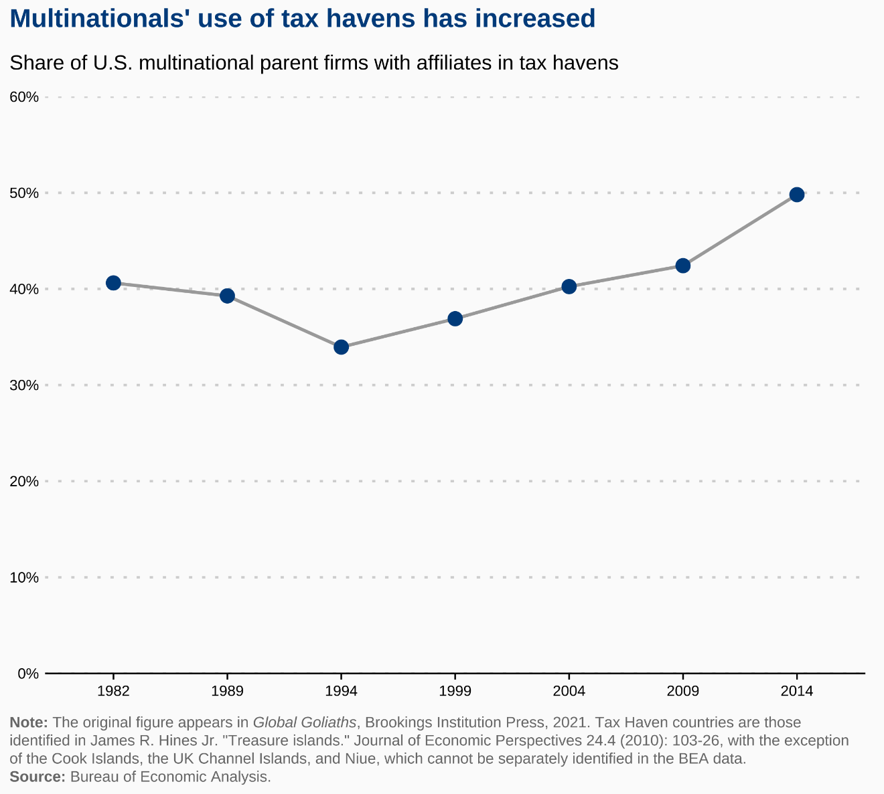

Slide 11
Income shifting and production incentives.
Back to the model of firm value.
This implies that
Note that higher tax rates do not have the same discouraging effect on local production as they would in the absence of income shifting. (In an extreme case in which all income is shifted to a zero-tax location then taxes have no effect.)

Slide 12
Home country taxes.
Suppose that the home country taxes foreign income at rate τ, granting a credit for foreign income taxes paid on that income.
Then if the average foreign tax rate is below the home country rate, all foreign income is effectively taxed at τ.
As a result, foreign taxes do not affect production location.
Is that right?
  If this is the U.S. system, then the U.S. taxpayer does not care about the tax rate where it earns profits.
  But foreign firms are not subject to the same rules.

Slide 13
The tax base sails away.
The pre-TCJA tax system subjected foreign profits to U.S. tax upon repatriation, or in the case of “passive” income, to immediate U.S. taxation.
In 1975 the U.S. repealed deferral of U.S. tax on foreign shipping income that was not reinvested in shipping.
In 1986 the U.S. repealed deferral of foreign shipping income altogether, and put shipping income into a separate “basket” for foreign tax credit purposes.
This persisted until the 2004 act, which restored deferral.

Slide 15
Another basket case.
The TRA 86 introduced a separate “basket” for each (!) foreign affiliate owned between 10% and 50% by U.S. owners.
These are international joint ventures, and this tax treatment was particularly punishing for affiliates in low-tax countries.
As a result, U.S. firms participated in far fewer international joint ventures post-1986, either by taking majority positions or just skipping them altogether.

Slide 16
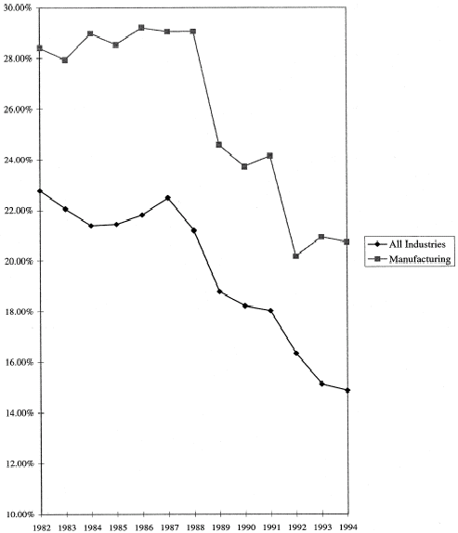

Slide 17
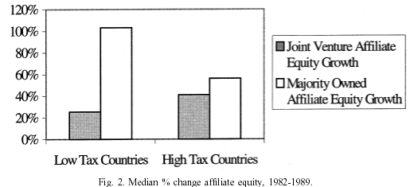

Slide 18
Tax sparing.
In the era of U.S. taxation of foreign income, a question arose about whether the U.S. would grant “tax sparing” credits for investment in developing countries.
“Tax sparing” is the practice of granting a foreign tax credit for taxes that would normally be paid, but were not, because the foreign government offers a tax holiday or other concession.
Other countries, such as Japan and the U.K., signed many treaties offering such credits.
The United States steadfastly refused to do so.

Slide 19
Spare me.
What is the effect of “tax sparing”?
Obviously, it makes it more attractive to invest in a country that offers tax holidays or other tax reductions to encourage investment.
So we should expect to see more FDI there.
Can compare U.S. v. Japanese investment in countries with whom Japan does, and does not, have tax sparing agreements.
Tax sparing is associated with greater Japanese investment; and one gets the same results using U.K. tax sparing agreements as an instrument.

Slide 21
Spare questions.
Why did Japan, the U.K., and other major capital exporting countries offer tax sparing?
Were they just nicer than the United States, or was there more to it?
Part of the U.S. objection to tax sparing is that it is an inelegant feature of the tax system.
Another is that it smacked of globalism; and the U.S. has always had some tax provisions designed to make foreign investment more expensive.

Slide 23
Different tax systems.
In the pre-TCJA period, the U.S. taxed foreign income with FTCs and the rest of the world mostly exempted foreign income.
This created a disadvantage for U.S. firms in low-tax foreign markets.
  Consider for example a U.S. and German firm competing to acquire a Singapore company.
As a result, the U.S. tax system discouraged investments in low-tax places relative to the incentives of multinationals from other countries.
So the system can affect investment patterns even though it seems to be neutral.

Slide 24
Neutralities.
Peggy Musgrave concept: “capital export neutrality.”
The idea is that the U.S. tax system subjects investments to the same overall tax whether domestic or foreign.
  Worldwide taxation with FTCs implements this.
An alternative: “capital ownership neutrality.”
CON is the notion that the relative preference for foreign investment is the same under U.S. taxation as it is under the tax systems of foreign countries.
  There is an element here of, if you can’t beat them, then join them.

Slide 25
Deferral.
Even pre-TCJA, U.S. taxes were due only on repatriated profits (or those deemed repatriated).
Dividend repatriations were grossed up by the foreign tax credits, and subject to tax.
Hence, remitting a dividend of $1 from a forign sub created a tax liability of
So a dividend remittance of $1 yields after tax

Slide 26
New view goes international.
Consider a mature foreign affiliate that finances its operations out of retained foreign earnings.
Any money it cannot profitably reinvest it remits to the parent as a dividend, D.
It chooses investments to maximize the present value of after-tax dividend remittances, or
But maximizing this is the same as maximizing the present value of D without repatriation taxes.
Hence U.S. taxation does not affect investment.

Slide 27
Foreign affiliate dynamics.
Can it be right that U.S. taxation of repatriated dividends does not affect foreign investment?
Well no: this applies only to mature affiliates.
And the taxation of foreign competitors still affects U.S. firms, even in this setting.
Furthermore, deferral creates its own incentives.
When the sub repatriates dividends it must be that the after-foreign-tax marginal product of capital equals the rate at which the parent company discounts dividends.
  If greater, should delay dividend repatriations.
Prior to paying dividends the after-foreign tax marginal product of capital is higher than the discount rate.
  So the capital stock must be lower than the steady state level.

Slide 28
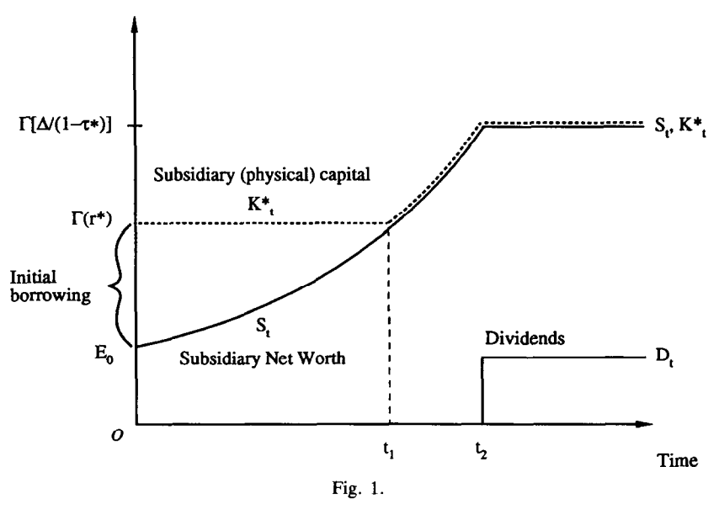

Slide 29
Debt and taxes.
Interest deductibility means that higher corporate tax rates encourage debt finance.
  Firms have incentives to locate their debt in the highest-tax countries, subject to being able to use deductions.
The effect is quite evident internationally, particularly if one compares leverage ratios of affiliates of the same firm.
Of course, thin-cap and related rules limit the extent to which debt financing is affected by tax rates; but these regulatory restrictions are quite crude and typically do not change the overall pattern of borrowing.

Slide 30
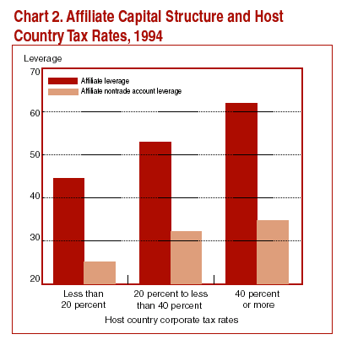

Slide 31
Inflation and taxes.
Consider an international capital market with foreign borrowers and lenders.
A foreign lender who lends to a U.S. borrower receives an after-tax real return of approximately
with r the U.S. interest rate, é the change in the exchange rate, and π* the foreign inflation rate.
θ* is the foreign tax rate on interest income, and g* is the foreign tax rate on exchange gains and losses.

Slide 32
Exchange rates.
Suppose that exchange rates are determined by purchasing power parity.
  This is the most compelling framework theoretically.
  The empirical evidence is controversial.
Then a country’s currency devalues at its rate of inflation, so
Consequently,

Slide 33
Lending.
Differentiate the borrowing equation
with respect to π, and set this equal to zero.
Imposing that
This produces

Slide 34
Inflation and capital.
What is implied by ?
If foreign lenders are taxed at the same rate on their interest income and exchange gains, then
This is not the Feldstein/Darby effect.
As a result, domestic inflation
  Reduces saving (after-tax real returns decline)
  Increases investment (after-tax borrowing costs decline)
  Causes capital inflows from abroad.

Slide 35
Why become a tax haven?
Becoming a tax haven permits you to attract foreign investment and the economic goodies that come with it.
Also, the alternative of trying to tax foreign investment is problematic for a small country.
  Theory suggests that it is not possible to impose tax burdens on foreign investors who always have other potential investment locations.
  Attempts to tax foreign investors simply reduce local wages in the end.
Why isn’t everyone a tax haven?
  It may not work for everyone.
  In particular, countries without good governance regimes are unable to attract foreign investment with low tax rates, and these countries seldom become tax havens.

Slide 36
Ratio of US FDI to GDP for 4 Groups of Countries

Slide 37
Characteristics of tax havens.
Compared to other countries, tax havens are:
  Smaller (most below 1 million in population).
  More affluent (high GDP per capita).
  Much better governed, as measured by political stability, rule of law, control of corruption and voice and accountability.
Moreover, tax havens are much better governed that other countries at the same level of affluence.
It seems likely that this reflects the importance of good government in attracting investment.

Slide 38
Governance and GDP (All Countries)

Slide 39
Governance and GDP (Small Countries)

Slide 40
Implications of tax competition.
Despite much greater international competition, we have not seen corporate taxes disappear.
What seems to be happening is that countries have lowered their taxation of highly mobile international investments, without reducing their taxation of purely domestic investments.
How should a country tax international income? The competitive incentive is to offer a low rate on income and activity that might flee elsewhere.
Countries that nevertheless persist in imposing high rates of tax on mobile sources of income simply reduce their own wages.
  High tax rates reduce investment from foreigners.
  This reduces demand for local labor, depressing wages.

Slide 41
Show me the money.
Without taxing foreign investment, how are governments to be financed?
More specifically, should one be concerned that tax competition will erode social welfare programs by making it impossible to finance these expenditures?
Probably not. Governments with significant social welfare programs have alternative revenue sources that are more efficient than taxing foreign investment.
  Almost any tax alternative looks better than taxing foreign investment.
  Taxes on foreign investment are usually small fractions of total revenue in any case.
Furthermore, national affluence largely determines welfare spending, not tax mix choices.

Slide 43
Harmonize this.
It is possible to evaluate circumstances in which international tax harmonization or worldwide minimum taxes advance government objectives.
Harmonization or minimum taxes address the problem of tax competition driving rates too low.
But they do so at the cost of imposing common rates that are insensitive to the situations and needs of individual jurisdictions.

Slide 44
Government objectives.
The objective function (willingness to pay) for government i has two arguments: the tax rate in i and the difference between the tax rate in i and the world average.
One can define as country i’s ideal tax rate in the absence of international tax competition:

Slide 45
The approximation…
Take a second-order Taylor approximation to in the neighborhood of
if it is costly to have

Slide 46
Implied tax rate choice.
The derivative of a function equals the derivative of its Taylor expansion, so if government maximizes its objectives,
…with the second order condition

Slide 47
Harmonization.
Aggregate objective satisfaction when tax rates are harmonized at :
Maximizing this implies:

Slide 48
The rule:
Substituting for the unobserved yields
with

Slide 49
The standard deviation rule.
Tax harmonization advances objectives only if tax competition reduces average tax rates by at least the standard deviation of observed tax rates.
  Both the standard deviation and the average effect of tax competition are weighted by country willingness to pay for desired tax rates.
The rule reflects the second-order nature of the cost of tax uniformity along with the second-order nature of the cost of having tax rates too low.

Slide 53
Tax rate implication:
Recall that
So
Any maximizing choice of must equal or exceed the average observed tax rate plus the standard deviation of observed rates.

Slide 54
What does all this depend on?
The second order approximation excludes higher order terms.
  This focuses the analysis, but it comes at the cost of possible loss of generality.
  Our current empirical understanding has little to say about whether and to what extent these third- and higher order terms might be important.
The model assumes that the harmonized rate is chosen based on perfect information.
The model assumes that what matters is comparison to the average tax rate.
  A version of the model with (restricted) individual country comparisons yields very similar results.

Slide 56
Partial harmonization via minimum tax rules.
Minimum tax rules fall in a class of partial harmonization measures.
Minimum taxes harmonize the taxes of an endogenously selected group B of countries that – conditional on the choices of others – prefer tax rates below the prescribed minimum .
The other group of countries, A, chooses tax rates , where may be affected by .

Slide 57
Analyzing minimum taxes.
The challenge is that with unrestricted strategic behavior, and therefore idiosyncratic responses to average tax rate changes, observed current tax rates do not tell you whether individual countries will fall in group A or group B.
One approach is to assume that countries have common strategic responses.

Slide 58
In the absence of strategic interactions in tax rate setting…
If , so tax rates are neither strategic complements nor strategic substitutes…
..then an efficient minimum tax choice entails
The objective-maximizing minimum tax rate equals the average observed tax rate of the constrained group B countries plus the average effect of tax competition in reducing tax rates for everyone.

Slide 59
Implications.
This is implementable, if you know the current effect of tax competition.
The rule implies that there are dominated regions of minimum taxes.
  For a given value of it will often be the case that more than one minimum tax rate satisfies the rule locally.
  The efficient rate is the one that better advances objectives, which usually entails skipping over wide ranges of rates.

Slide 60
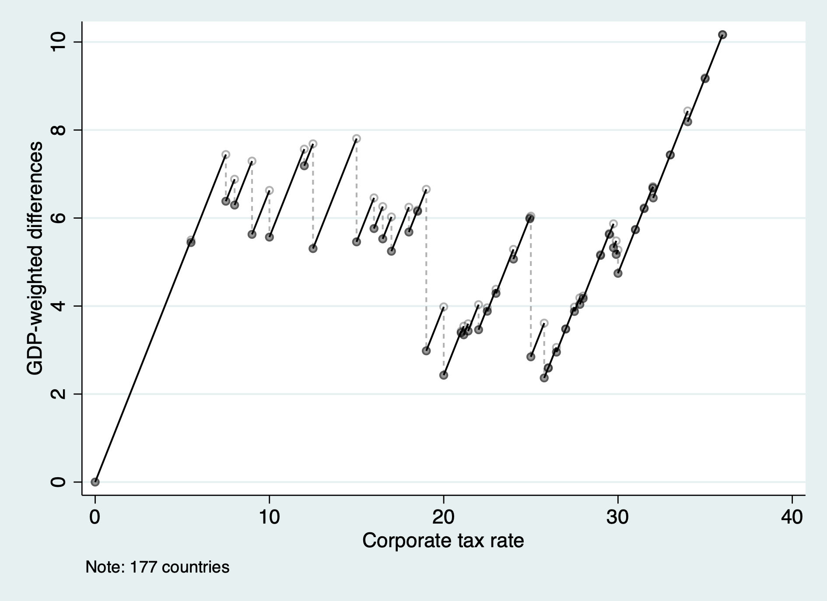
At a tax rate of 20%, the average tax rate of countries with rates equal to or less than 20% is 17.7%, so the difference is 2.3%.

Slide 61
If tax competition reduces average tax rates by 2%, then the
efficient minimum tax rate is also 2%.

Slide 62
If tax competition reduces average tax rates by 8%, then the
efficient minimum tax rate is 34%.

Slide 63
If tax competition reduces average tax rates by 4.5%, then three tax rates –
4.5%, 23.2%, and 28.1% – satisfy the rule for efficient minimum tax rates.

Slide 64
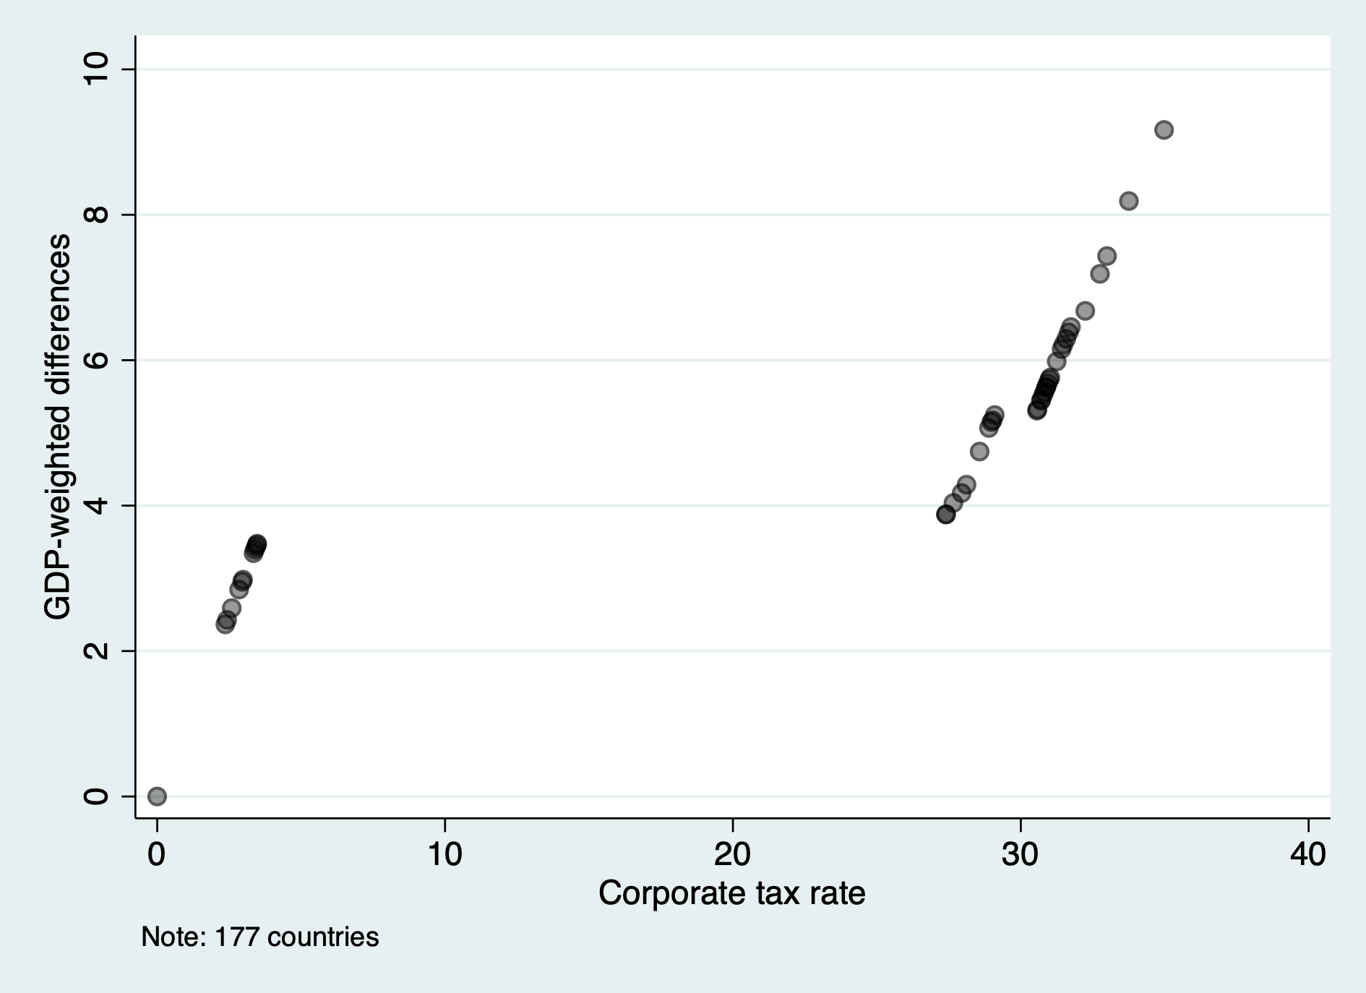

Slide 65
Implications.
If tax competition depresses average tax rates by 3.8% or less, then the efficient minimum tax rate is below 4%.
If tax competition depresses average tax rates by more than 3.8%, then the efficient minimum tax rate is above 27%.
The range 4-27% is a dominated region for the minimum tax.
These calculations weight countries by GDP; weighting by population looks very similar; and even equal-weighting all countries, big and small, yields results with many of these features.
Explicitly incorporating strategic interactions changes the pattern of implications rather little.

Slide 66
Why dominated regions?
Minimum taxes have dominated regions because they directly affect only countries with rates below the minimum.
If tax competition depresses tax rates, then it would be most efficient to raise the tax rates of all countries.
Increasing the minimum tax rate allows the minimum tax to reach more countries at the cost of further distorting outcomes for countries that want really low rates.
  This makes sense to do only if there is a heavy concentration of countries at somewhat higher tax rates.
Jumps in the efficient minimum tax function reflect that the collective objective function has convex and concave regions.
  The 2nd order Taylor approximation does not produce this – but the distribution of preferred tax rates can, and apparently does.

